Slide 1
AI-Betes Advisor
By: Gaurang Solanki, Jasmine Joy, Udiptaman Das, and Daniel Rider

Slide 2
Introduction
Main motivation behind our project:
Lack of existing resources that contains multiple necessary features under a single environment.
Not everyone can access professional medical attention at any time of the day.
Managing diabetes is not easy for patients when they are not under constant supervision.

Slide 3
Data
Diabetes prediction dataset is chosen to train our predictive model.
It contains features that actually have significant impact on diabetes status, such as age, BMI, hemoglobin level, blood glucose level and so on.
This dataset helps to determine whether a person is diabetic(1) or not(0).

Slide 4
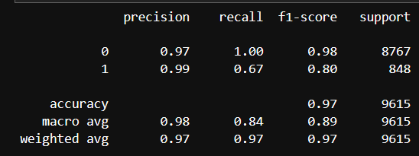
Model
XGBoost classifier shows best performance in terms of precision, recall, f1 score and roc auc score.
Other advanced models like neural networks tend to overfit.
All classifiers were trained on train set(60571), tuned hyperparameters using validation set(25960) and tested on test set(9615).
Classification report on test set can be seen alongside.
Score | Train | Validation | Test
F1 | 0.803 | 0.803 | 0.801
ROC AUC | 0.8364 | 0.8359 | 0.8353

Slide 5
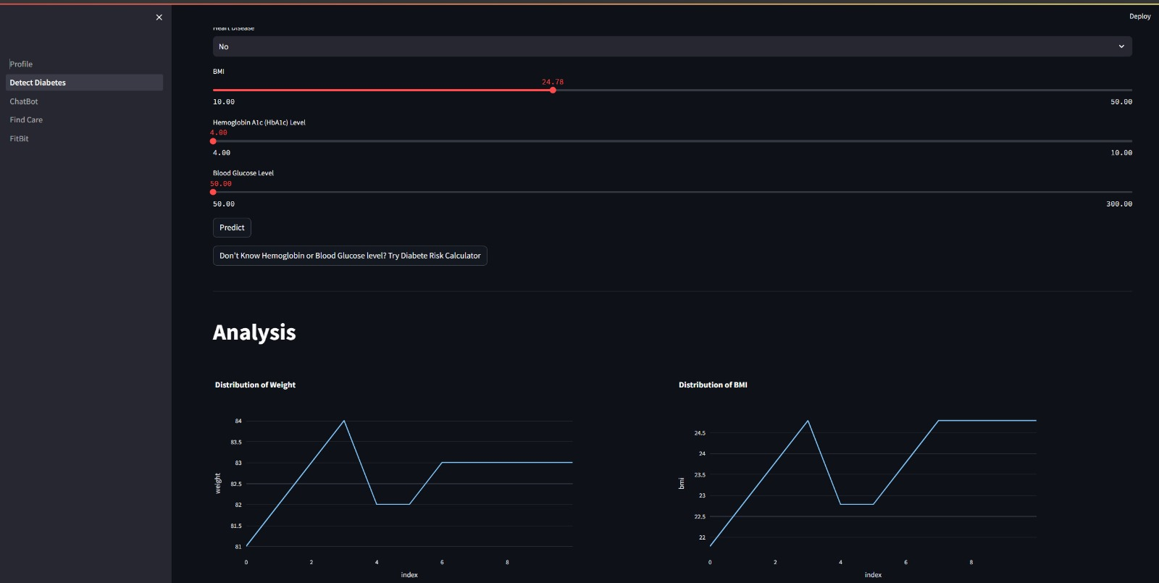
Overview

Slide 6
Conclusion
Here is what we have achieved so far:
Working web page where users can create accounts and enter requested information.
Users have the choice for predicting diabetes status based on available information.
If users do not have all the informations, they can still calculate risk scores for type-II diabetes.
Real time visualization of various health factors like BMI, blood glucose level, etc.
ChatGPT powered chatbot for the user to follow up on status and offer relevant recommendations on healthy habits and diets depending on their current health condition.
Google maps integration to help users find nearby health specialists.

Slide 7
Future works
Speech to text.
ChefGPT.

Slide 8
Thank you

